Slide 1
Gift Giving for Children

Slide 2
Things to Stack and Build
Notes:
https://a.co/d/ftSyucV https://a.co/d/3hv9tK6

Slide 3
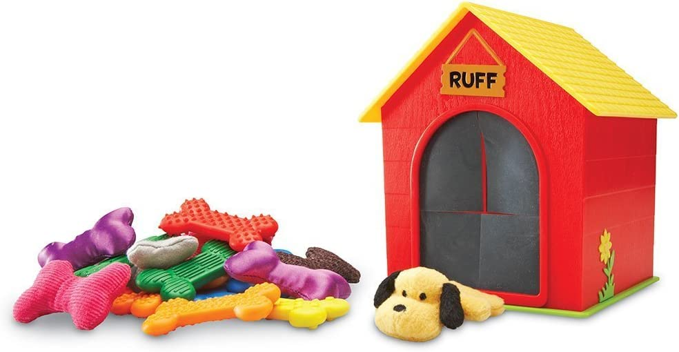
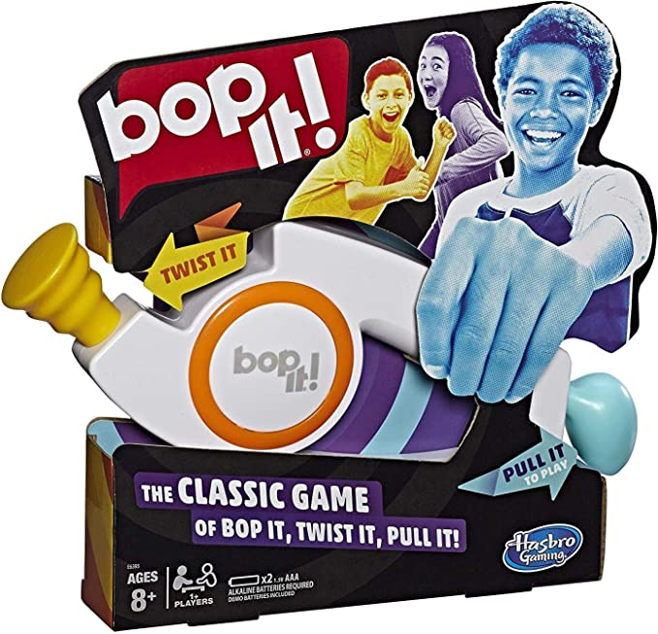
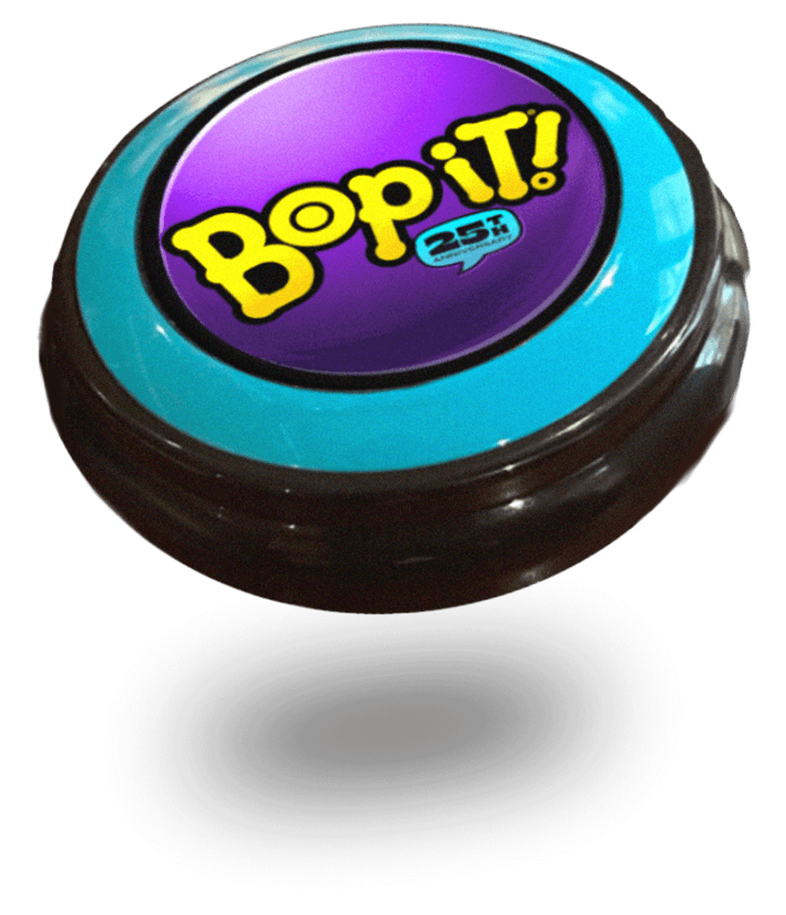
Games
Notes:
Bop it: https://a.co/d/927wA6o Ruff’s House: https://a.co/d/b4WUtX9 Go Fish - Braille https://thelowvisionstore.com/products/braille-go-fish-flash-cards Sensory Memory Matching Game https://specialneedstoys.com/usa/visual/sensory-memory-matching.html Bop It Bop It For Good

Slide 4
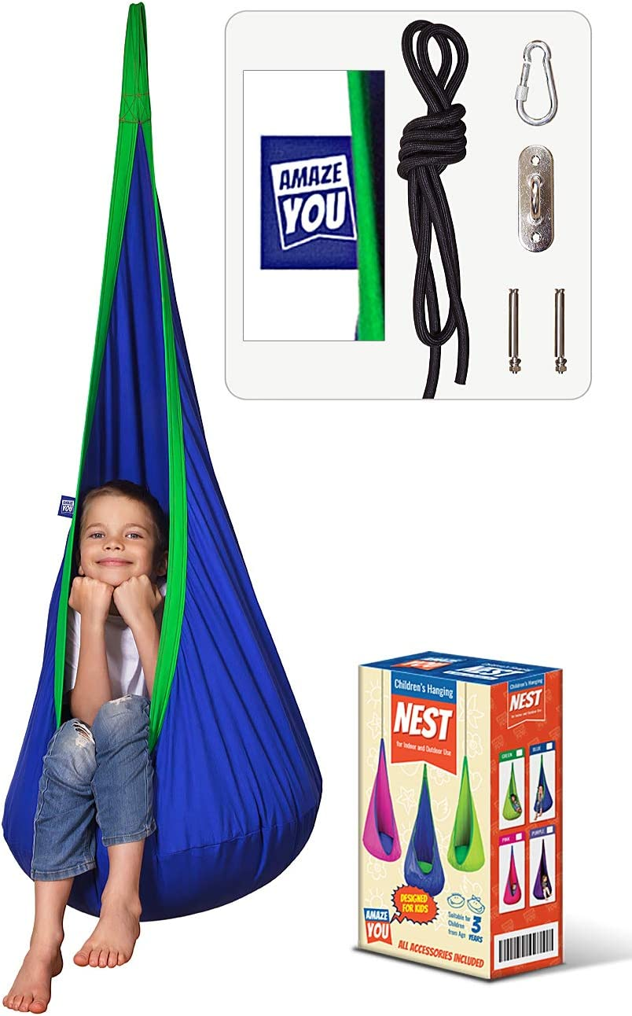
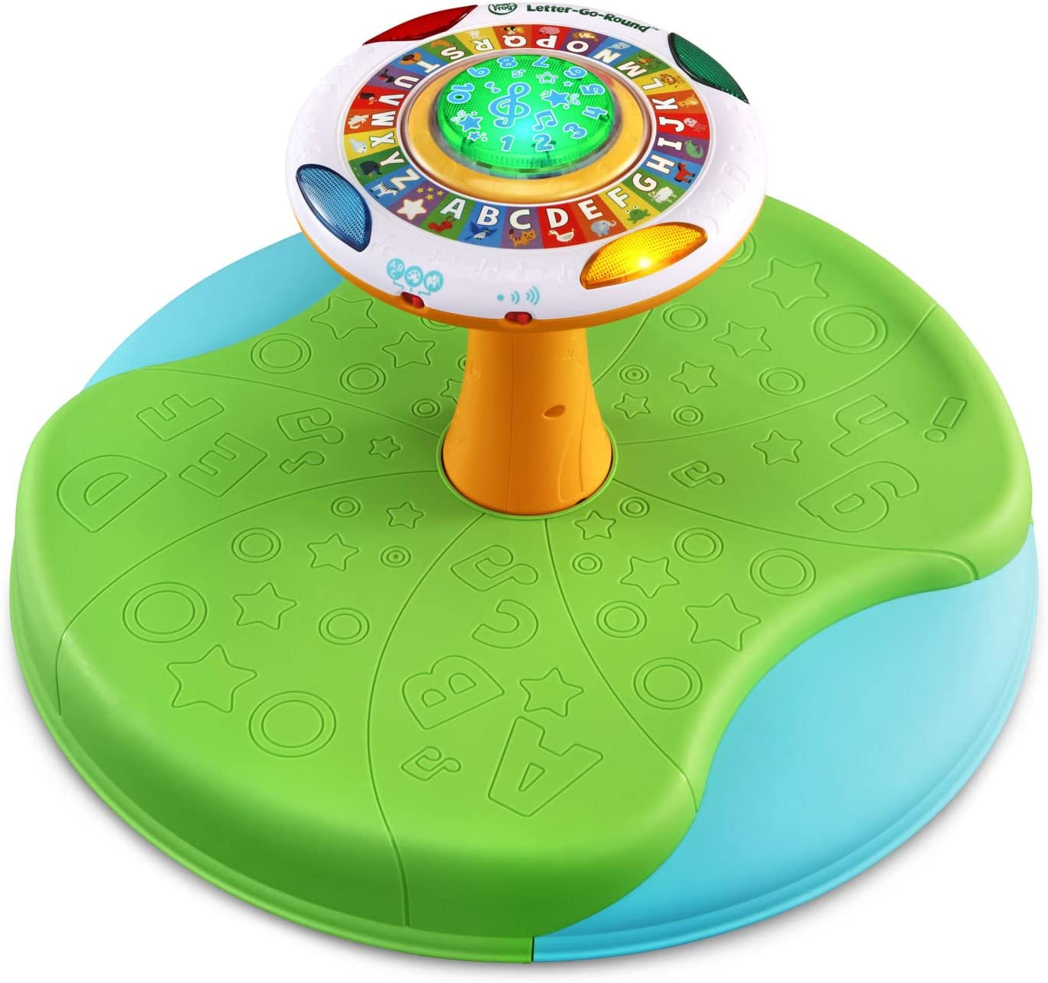
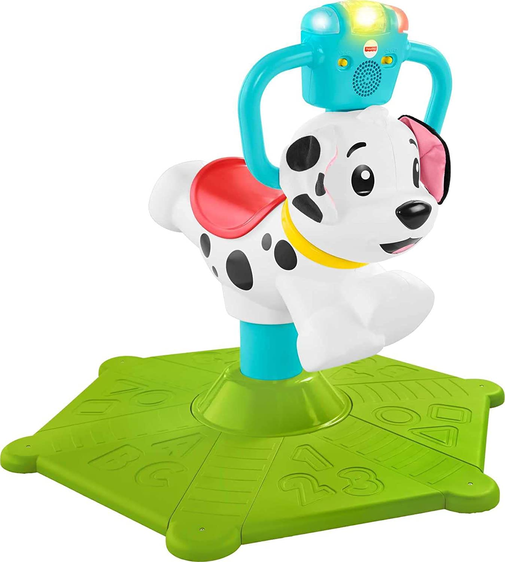
Movement
Notes:
Teeter Popper https://a.co/d/0PIKDhs Sit ‘N Spin: https://a.co/d/4rH6RQq Bounce and Spin https://a.co/d/6puA6zH Indoor Swing https://a.co/d/i25RS2i

Slide 5
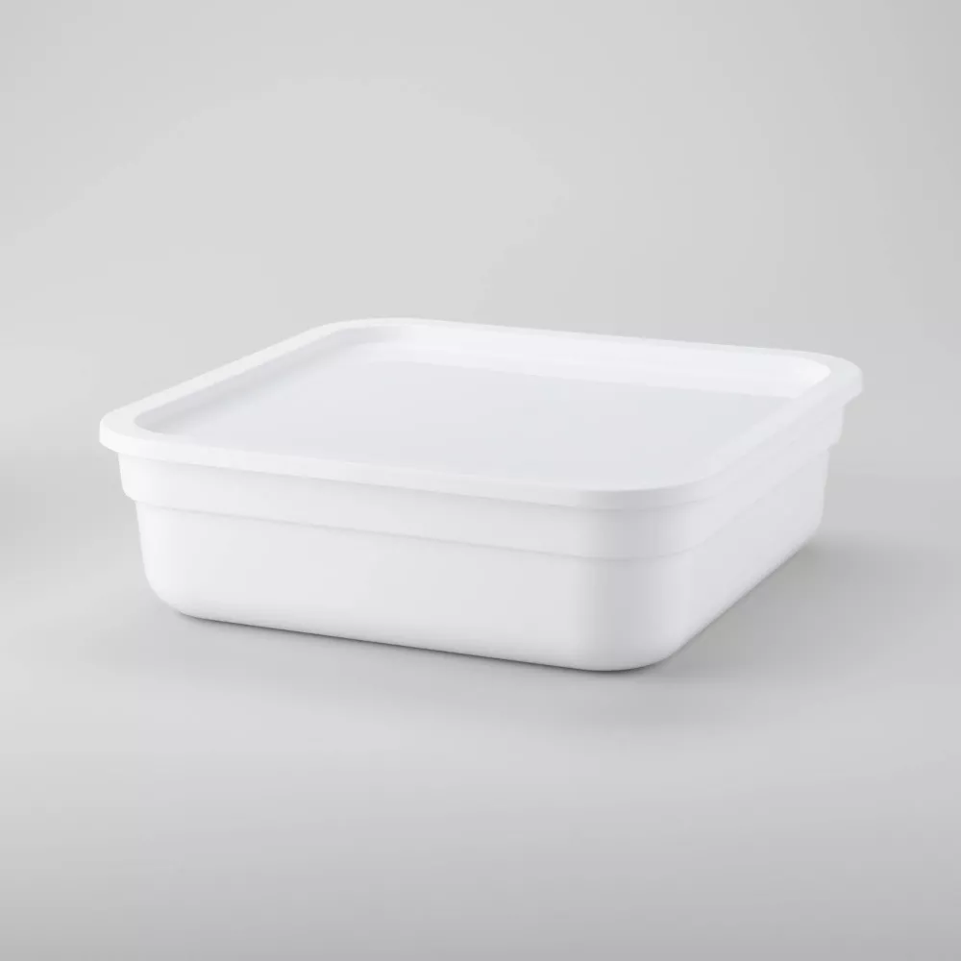
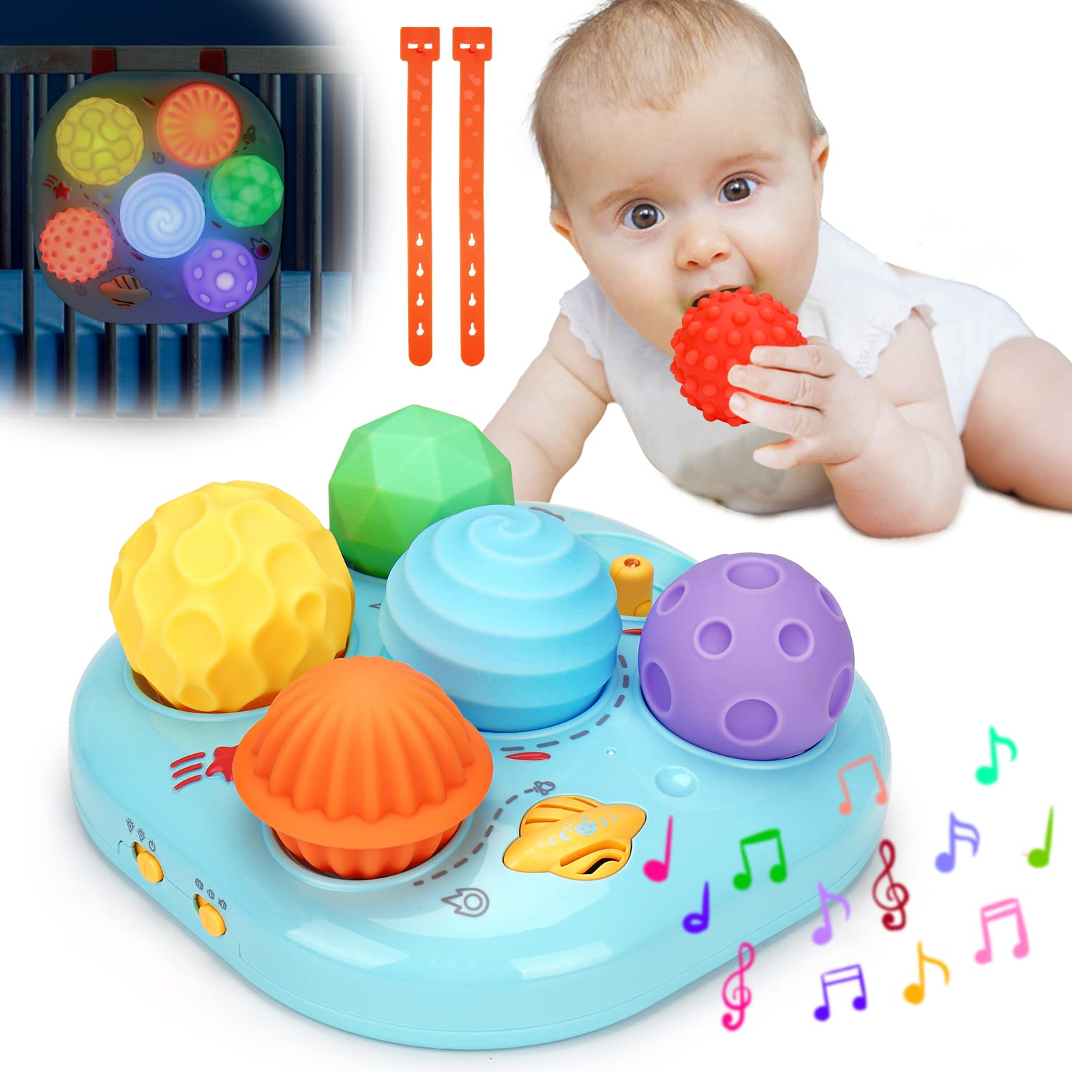
Sensory
Plastic dish pan
Rice Krispies
Spray bottle with water
Small plastic animals, bugs and/or wind up toys
Plastic shovel (optional)
Fill dish pan about 1/2 full with Rice Krispies
Hide small plastic animals, bugs or wind up toys in the cereal
Allow children to spray Rice Krispie treats to hear the ‘snap, crackle and pop’ and then dig (using the shovel) for the hidden toys!
Use coffee beans instead of cereal to dig for treasure and to play ‘coffee shop’. This would add the sensory experience of smell to the activity (spray bottle unneeded).
Fill the dish pan with beans, rice, pom poms, rocks, sand or any variety of textures to gain different sensory experiences
Use brightly colored fruit loops for kids with visual impairments
Use different utensils for ‘digging’ including tongs, kitchen utensils and brushes
Notes:
Musical Light Up toy Sensory Tactile https://a.co/d/4LJ9IxJ Sensory Bin Storage: Small Modular Storage Box - Brightroom™ : Target

Slide 6
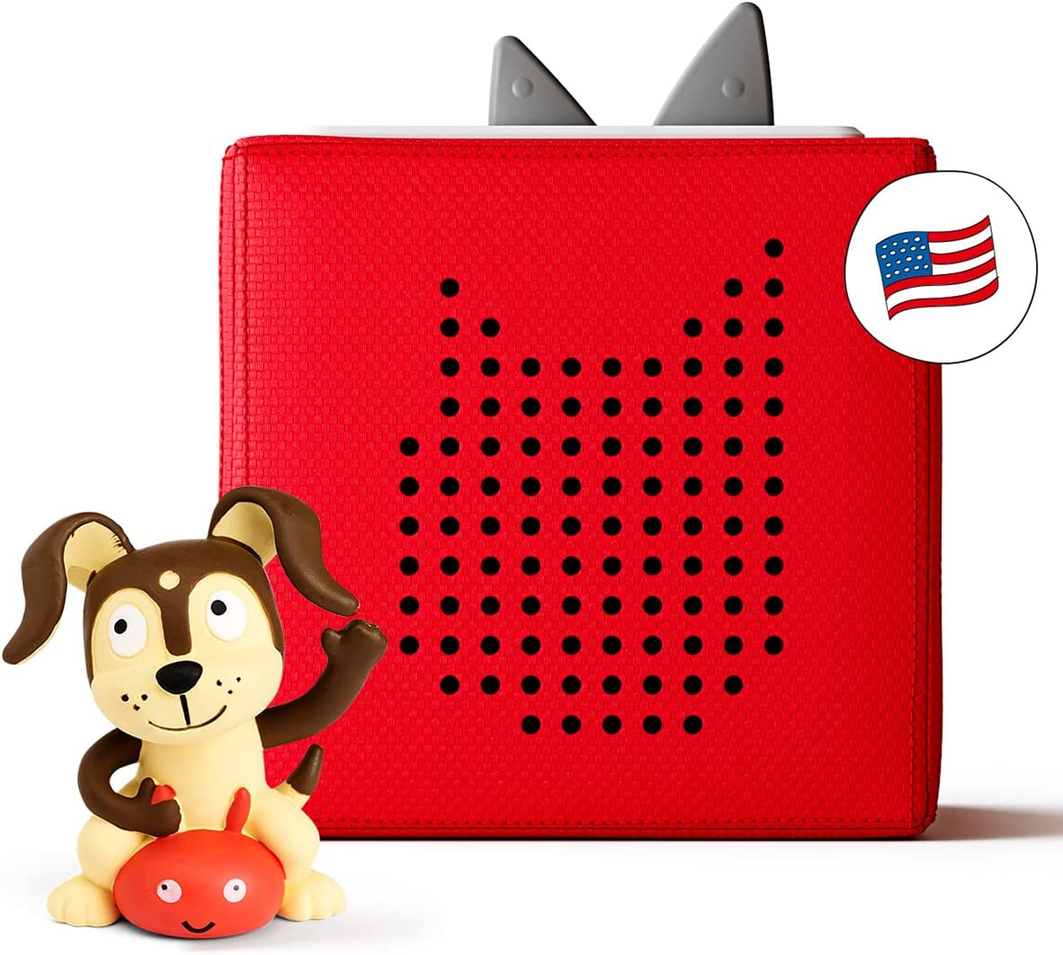
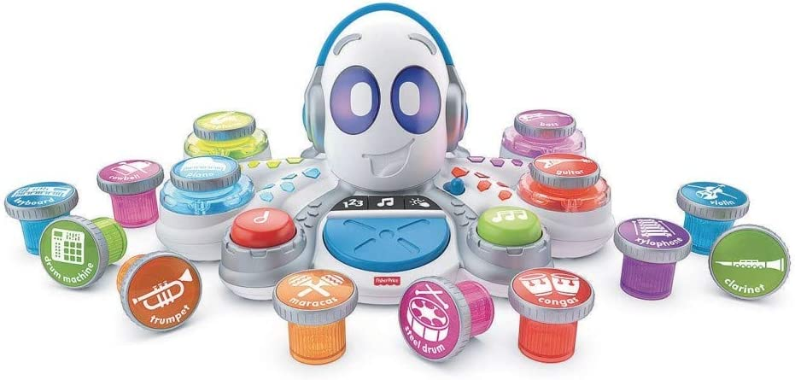
Musical
Notes:
Musical Turtle: https://a.co/d/8ycQbwo Rocktopus: https://a.co/d/3co0vcM Symphony Musical Toy Orchestra: https://a.co/d/6Q8LzxO Toniebox Audio Player: https://a.co/d/4cZiQIC

Slide 7
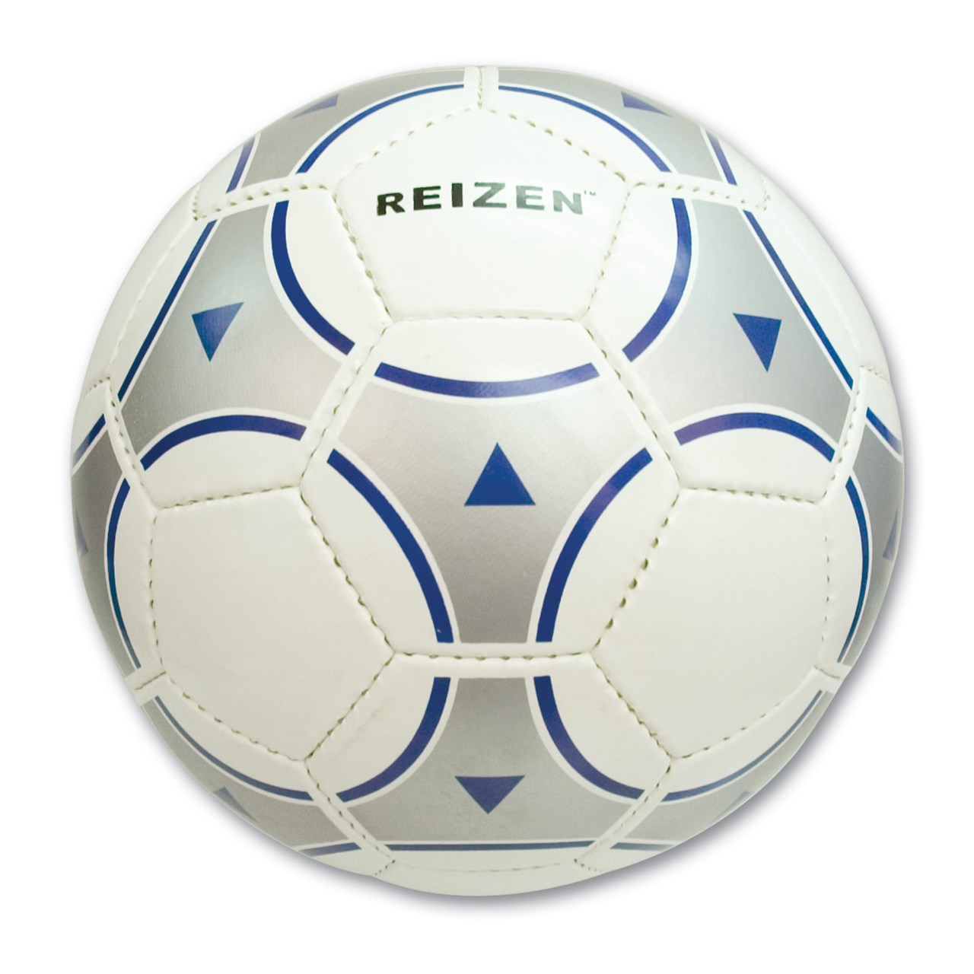
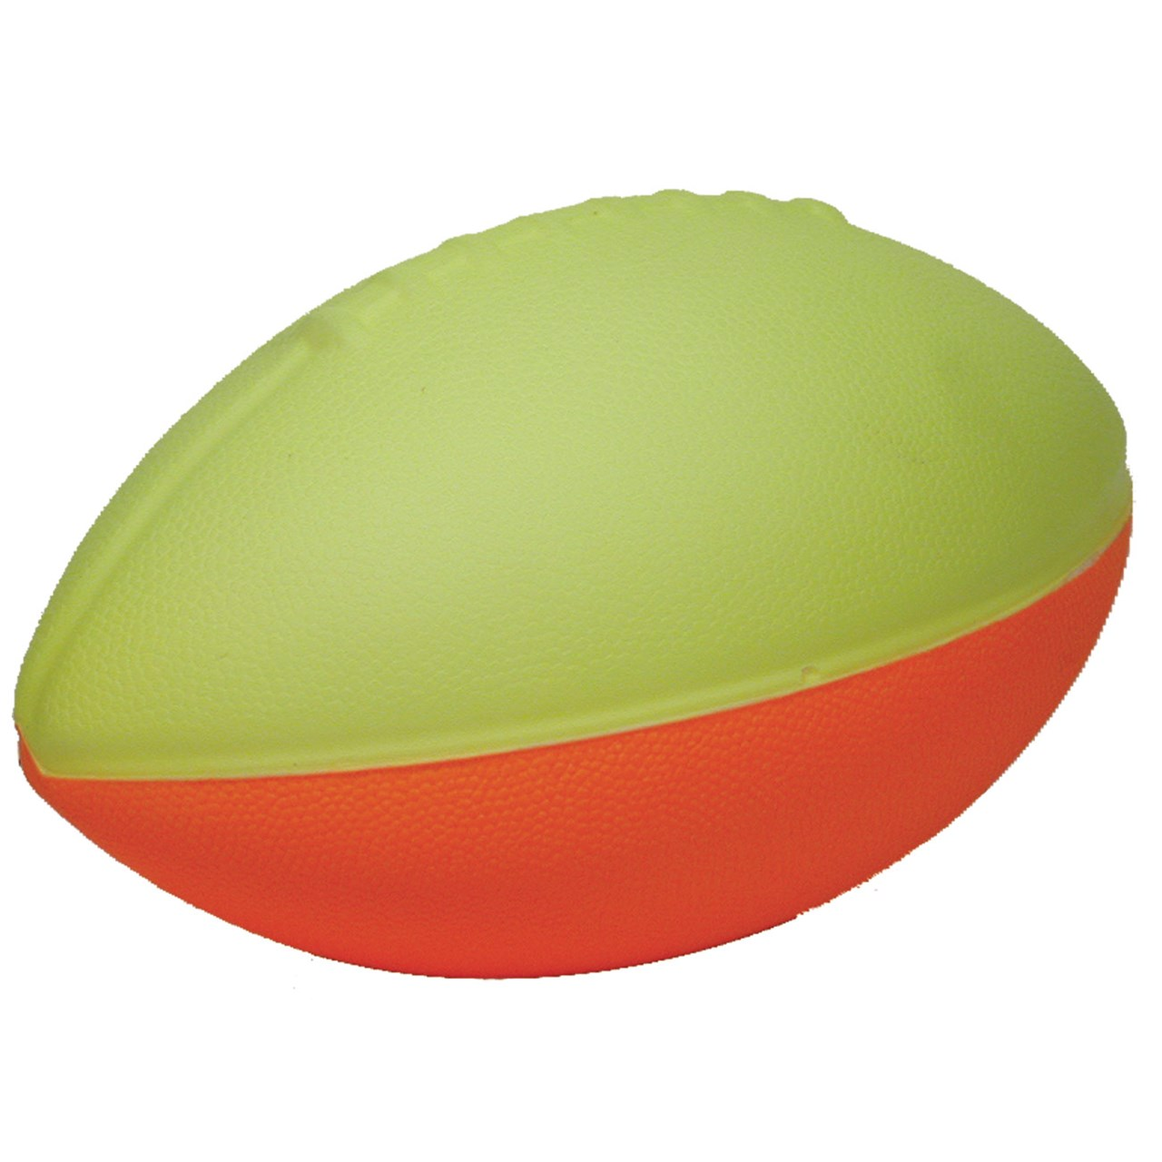
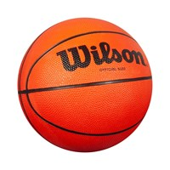
Sports
Notes:
Rib-It-Ball Rib-It-Ball: Jacob's, 18 Inch | American Printing House (aph.org) Basketball with double bells MaxiAids | Basketball w-double bells only Beeping Foam Football MaxiAids | Beeping Foam Football Soccer Ball: MaxiAids | Reizen Samba Soccer Ball with Bells

Slide 8
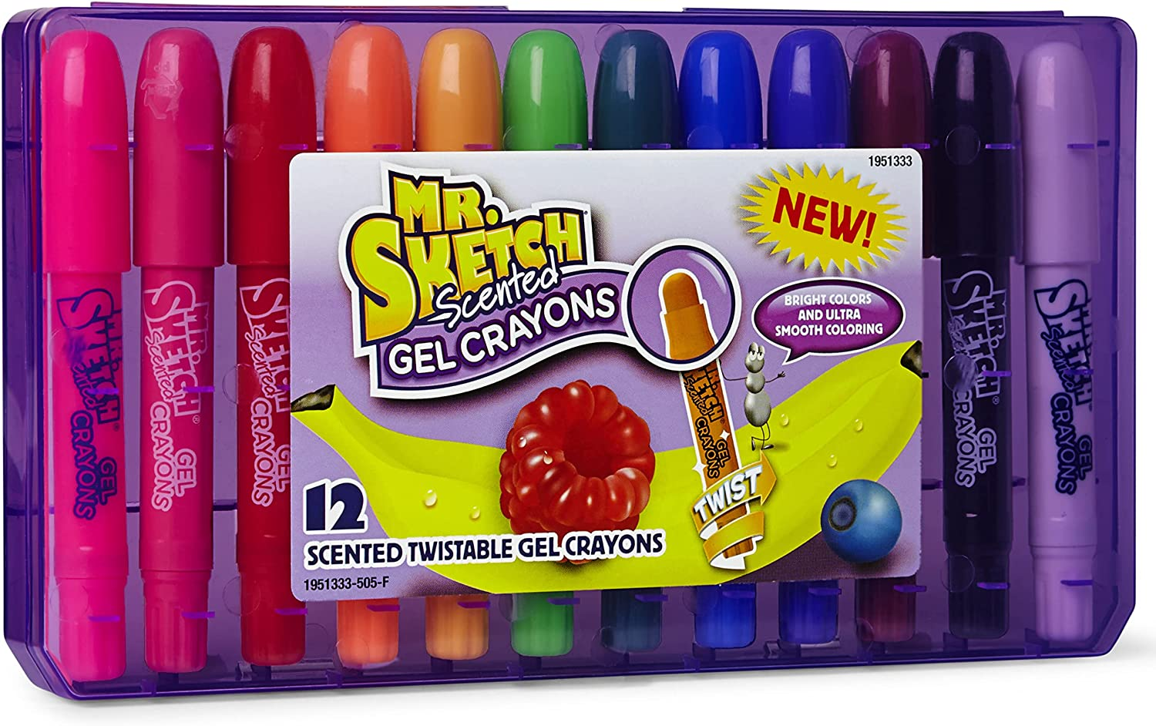
Arts and Crafts
Notes:
Color-by-Texture Marking Mats: Color-by-Texture Marking Mats | American Printing House (aph.org) Color Sensation – Raised Line Art and Braille: Amazon.com: Raised Line and Braille Watercolor Art Set : Health & Household Gel Crayons: https://a.co/d/cjCgCuH

Slide 9
Books and Story Boxes
Use a favorite book.
Include realistic items to represent the book, could be fabric that represents fur, candles to represent the smell of cookies, sounds from YouTube for animals or actual food in the story.
Simple storage for the book and all of the materials. Consider a photo box container, plastic container or bag.
When reading the story present the child with the item and allow for time to explore items.

